Slide 1
INDUSTRIAL BUILDINGS
Introduction-
Any building structure used by the industry to store raw materials or for manufacturing products of the industry is known as an industrial building.
Industrial buildings may be categorized as
-Normal type industrial buildings and
- Special type industrial buildings.
1

Slide 2
INDUSTRIAL BUILDINGS- NORMAL TYPE
Normal types of industrial building are shed type buildings with simple roof structures on open frames.
These buildings are used for workshop, warehouses etc.
These building require large and clear areas unobstructed by the columns.
The large floor area provides sufficient flexibility and facility for later change in the production layout without major building alterations.
The industrial buildings are constructed with adequate headroom for the use of an overhead traveling crane.

Slide 3
INDUSTRIAL BUILDINGS- SPECIAL TYPE
Special types of industrial buildings are steel mill buildings used for manufacture of heavy machines, production of power etc.
The function of the industrial building dictates the degree of sophistication.

Slide 4
Building configuration
Typically the bays in industrial buildings have frames spanning the width direction.
Several such frames are arranged at suitable spacing to get the required length .
Depending upon the requirement, several bays may be constructed adjoining each other.

Slide 5
Building configuration…..
The choice of structural configuration depends upon
the span between the rows of columns,
the head room or clearance required
the nature of roofing material and
4. type of lighting.
If span is less, portal frames such as steel bents or gable frames can be used .
but if span is large then buildings with trusses are used.

Slide 6
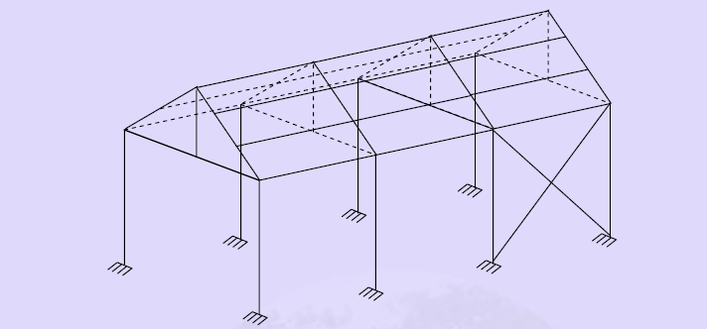

Slide 7
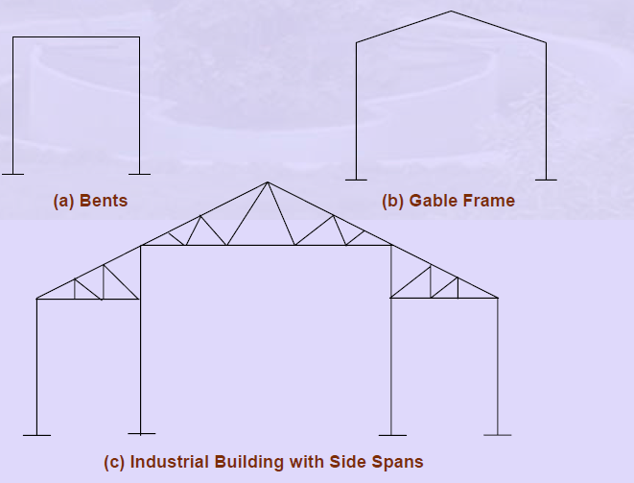

Slide 8
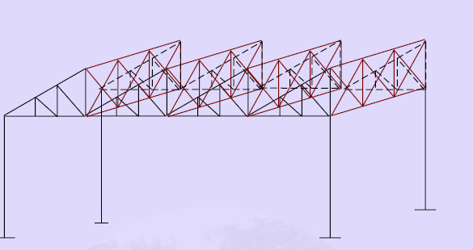
Typical lay out of an industrial structure

Slide 9
Floors of industrial buildings…
Different types of floor are required in any factory
from their use consideration such as
production,
workshop,
stores,
amenities, and
administration.
The service condition will vary widely in these areas, so different floors types are required.

Slide 10
Floors….
Industrial floors shall have
sufficient resistance to abrasion, impact, acid action and temperatures depending on the type of activity carried out.
High strength and high performance concretes can satisfy most of these requirements economically and is the most common material used.

Slide 11
Foundation….
Foundation for vibrating machinery (such as reciprocating and high speed rotating machinery) should be placed upon rock or firm ground and
it should be separated from adjacent floor to avoid vibrations.

Slide 12
Roof System
While planning a roof, designer should look for following quality
lightness,
strength,
water proofness,
insulation,
fire resistance,
cost,
durability and
low maintenance charges.

Slide 13
Roof….
Sheeting, purlin and supporting roof trusses supported on column provide common structural roof system for industrial buildings.
various factors, which are given consideration while designing the roof system.
The type of roof covering,
its insulating value,
acoustical properties,
appearance from inner side,
Weight
maintenance

Slide 14
Roof…
roof covering materials are-
Brittle sheeting such as asbestos, corrugated cement sheets
ductile sheeting such as galvanized iron corrugated profiled sheets

Slide 15
Lighting in industrial buildings
Industrial operations can be carried on most efficiently when adequate illumination is provided.
The requirements of good lighting are its intensity and uniformity.
economical and wise to use daylight
most satisfactory for illumination in industrial plants whenever practicable.
Side windows –good- in lighting the interiors of small buildings
but they are not much effective in case of large buildings.
In case of large buildings monitors are useful

Slide 16
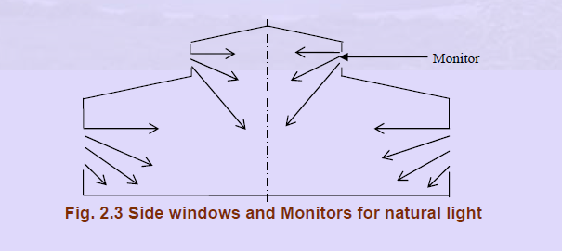

Slide 17
Ventilation
important
Ventilation -used for
  removal of heat,
  elimination of dust, used air
  Replacement of used air by clean fresh air
It can be done by means of natural forces such as aeration or by mechanical equipment such as.
The large height of the roof may be used advantageously by providing low level inlets and high level outlets for air.

